Slide 1
Dealing with Other Nations

Slide 2
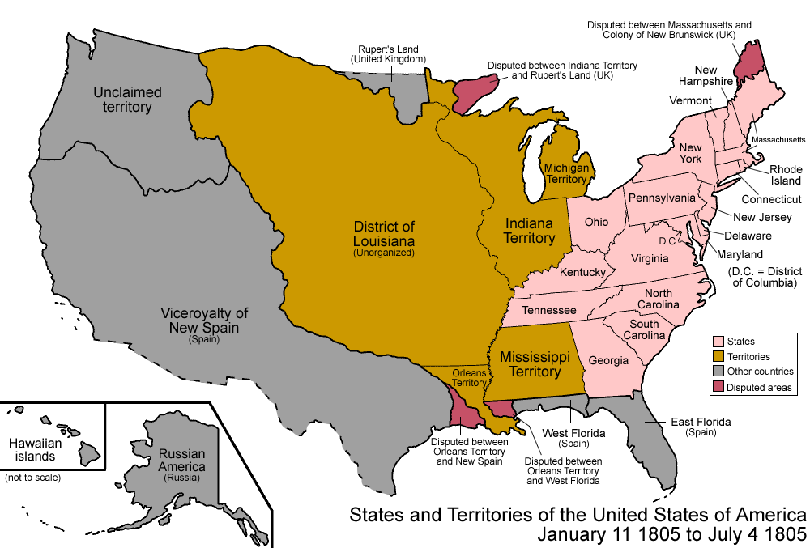

Slide 3
The Monroe Doctrine
“In the wars of the European powers in matters relating to themselves we have never taken any part…we owe it, therefore, to candor and to the amicable relations existing between the United States and those powers to declare that we should consider any attempt on their part to extend their system to any portion of this hemisphere as dangerous to our peace and safety”

Slide 4
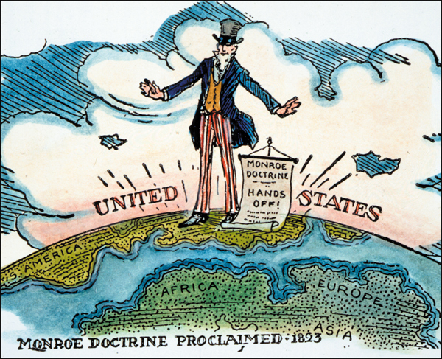

Slide 5
Questions to Answer:
Why did Spain cede Florida to the US?
How did Spanish territories revolting become American states?

Slide 6
Relations with Spain
1812 – Only U.S. and Haiti out of European control
Spain’s control over Florida was weakening
Escaped slaves joined the Seminoles in their fight with America
1817 – General Andrew Jackson destroys Seminole forts/villages
Forces Spanish settlers to flee, including governor

Slide 7
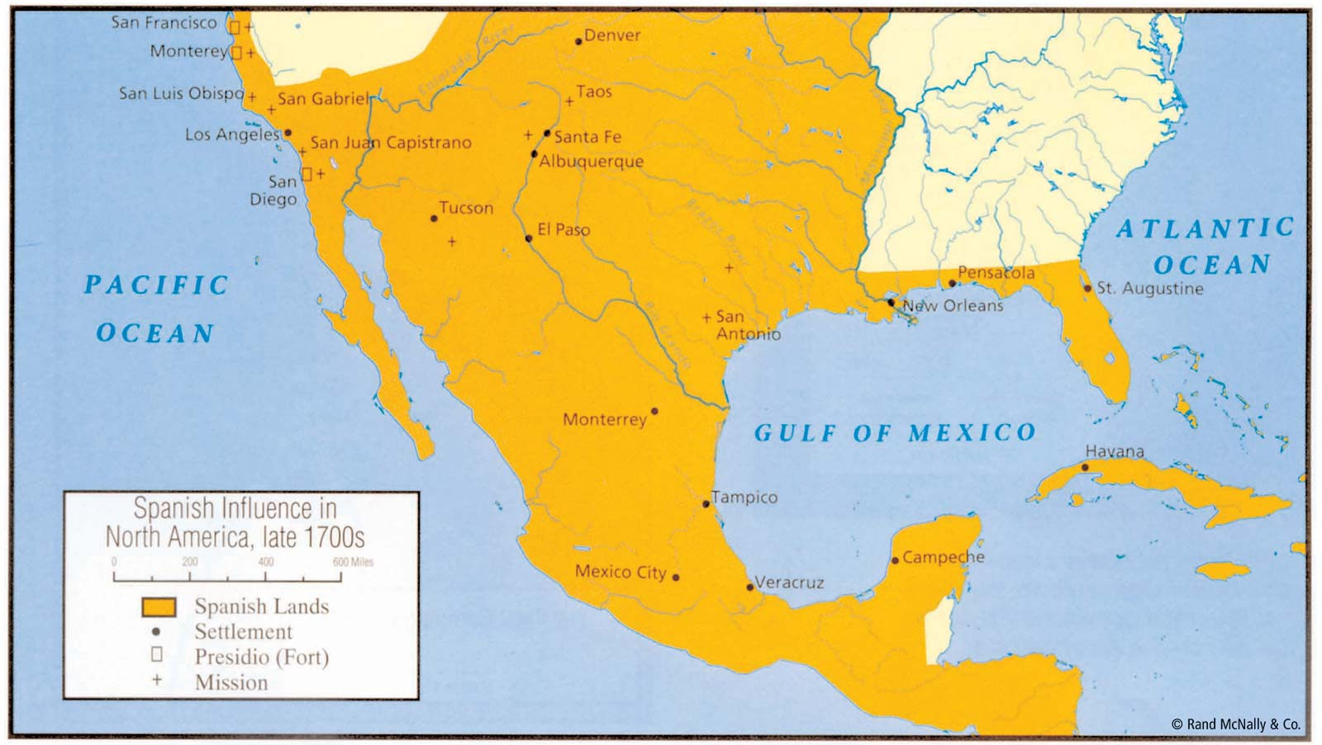

Slide 8
Florida
Jackson’s attack showed the vulnerability of Florida to attack
Spain decides to sell Florida rather than lose it in battle
Adams-Onis Treaty of 1819, Spain ceded, or gave up, Florida to the U.S.

Slide 9
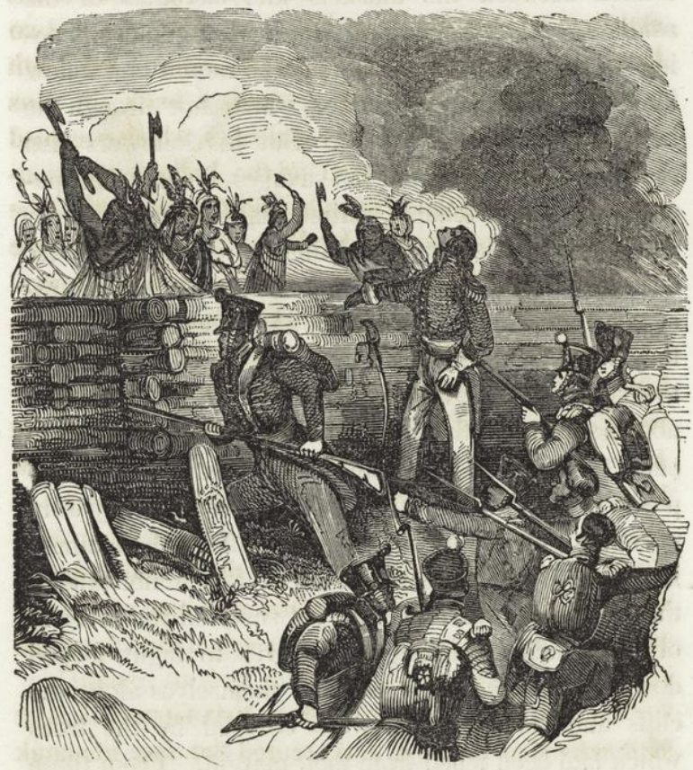
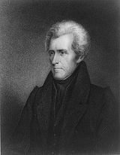

Slide 10
Spanish Colonies Win Independence
Post-1810 Latin Americans were pursuing self-rule
Revolutionary movements inspired by America and Haiti begin to take place

Slide 11
Mexico
Miguel Hidalgo – organized Native American army and overthrew Spanish control in several villages
Captured and executed, becomes national hero
1821 – Spain agrees after another revolution to release Mexico
Becomes a federal republic, modeled after the U.S.

Slide 13
South America
Simon Bolivar – Leads army on incredible march through the Andes and defeats the Spanish army in Columbia
Territory Spain loses includes Venezuela, Colombia, Ecuador, and Panama

Slide 14
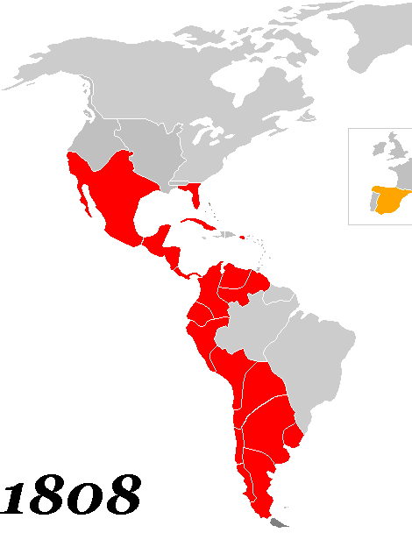

Slide 15
Central America
With Mexican support, Central American peoples declare independence
Includes Nicaragua, Costa Rica, El Salvador, Honduras, and Guatemala

Slide 16
Portugal
Brazil declares independence in 1822
United States acknowledges the new government
By 1825 most of Latin/South America was self-ruled!

