Slide 1
Terms and People
nullification – an action by a state that cancels a federal law to which the state objects
Martin Van Buren – President of the United States who succeeded Andrew Jackson
William Henry Harrison – Whig candidate who defeated Van Buren in the 1840 presidential election

Slide 2
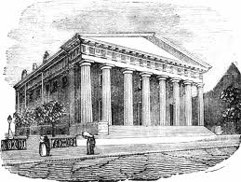
The Bank War
The 2nd Bank of the US created a safe and stable environment
Loaned safe loans
Held the U.S.’s money
Paper money
The 2nd Bank of the U.S. restricted all loans to those that were safe
Farmers, southerners could not get the loans
Blamed for a recession in 1819

Slide 3
The “MONSTER BANK”
The bank allowed a small minority of wealthy to enrich themselves, while keeping the everyday citizen penniless
When Andrew Jackson was sick in bed he said “The Bank…is trying to kill me, but I will kill it!”
Nicholas Biddle was the President of the Bank, a wealthy prominent Philadelphian
Jackson vetoes the Bank renewal from Congress

Slide 5
Reelection in 1832
With the use of the veto, Presidential power grew
Most voters supported Jackson’s veto of the Bank renewal
Henry Clay supported the Bank, but was defeated in a landslide
Jackson made sure the Bank never received its charter while he was in office, dooming Martin Van Buren during the coming recession

Slide 6
Read and Decipher
“We must be blind to the lessons of reason and experience not to see that the more a government interferes with the labor and wealth of a community, the more it exacts from one portion and bestows on another”
- Vice President John C. Calhoun

Slide 7
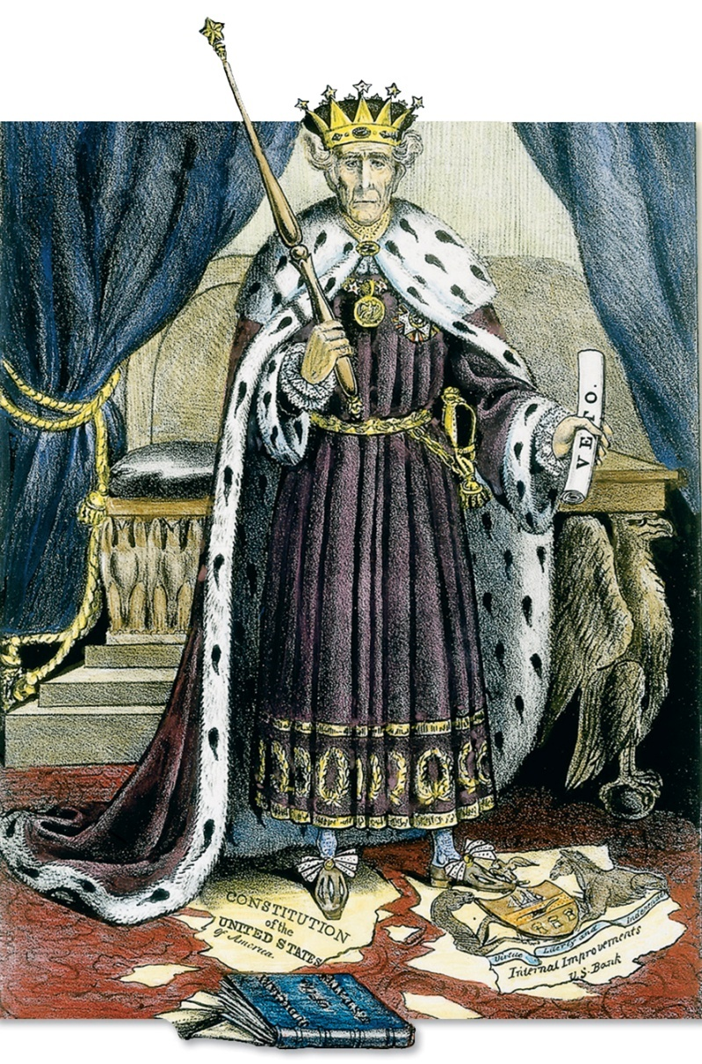
Andrew Jackson
Although he had popular support, the national press ridiculed President Jackson for his quick temper and steely will.
They portrayed him as a king that trampled on rights protected by the Constitution.

Slide 8
Nullification Crisis
Since the nation’s founding, Americans had debated over the balance of power between the states and the federal government.
The Constitution gave the federal government many significant powers.
The Tenth Amendment reserved rights for the states and the people.
Federal Power
State Power

Slide 9
Nullification Crisis
In 1828, the debate over states’ rights reached a crisis level.
Congress passed a law raising tariffs on iron, textiles, and other products.
Manufacturers in the North and some parts of the West supported the law.
Southerners felt the law was unfair. It made them pay more for goods.
Vice President John C. Calhoun agreed with the Southerners. He argued that the states had the right of nullification.

Slide 10
Nullification Crisis
Arguments for Nullification
Arguments Against Nullification
America was formed from an agreement between states.
America was formed by the entire American people.
States kept certain powers.
Daniel Webster argued, “We are all agents of the same supreme power, the people.”
States had the power to nullify unjust laws.

Slide 11
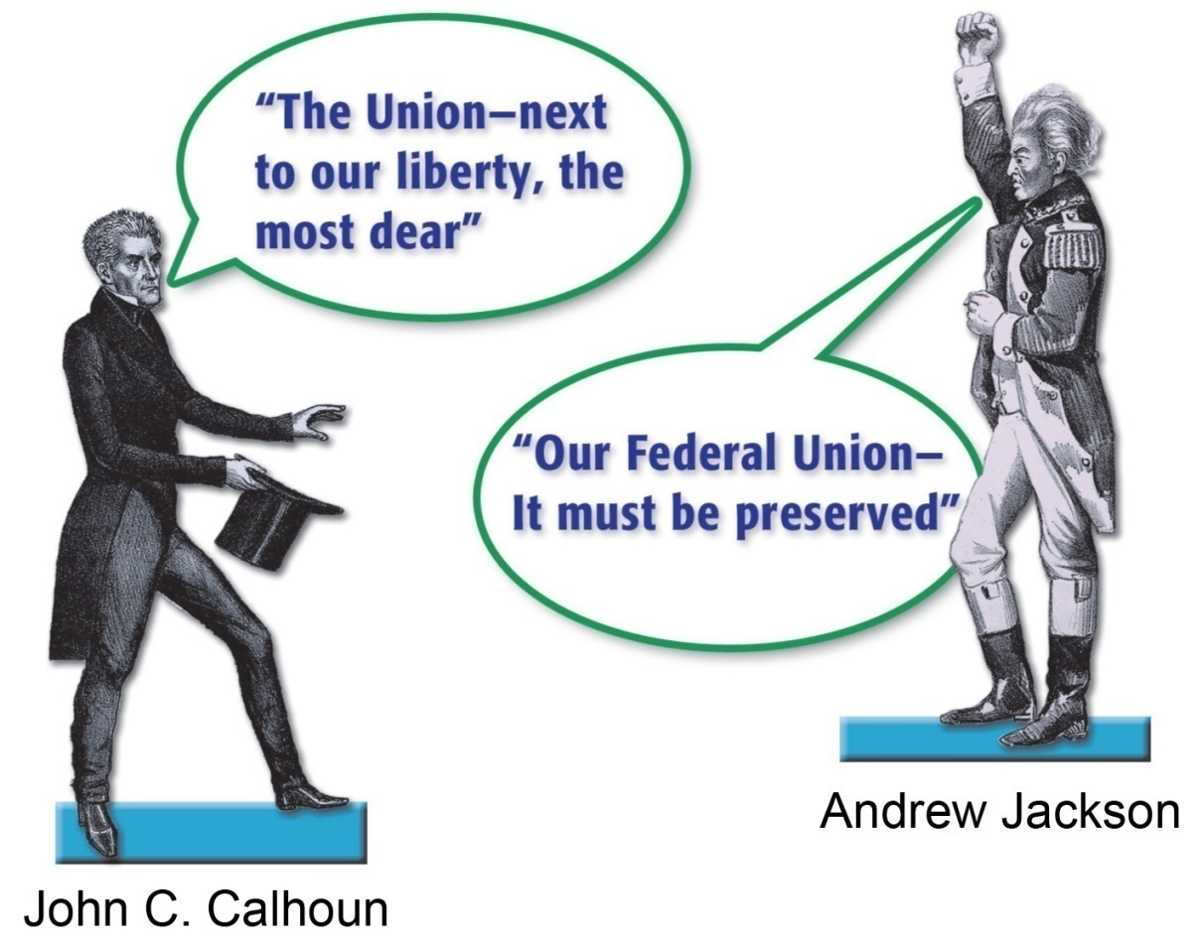
Nullification Crisis
President Jackson and Vice President Calhoun became bitter enemies due to their opposing views on states’ rights and nullification.
Calhoun resigned in 1832 and was replaced by Martin Van Buren.

Slide 12
Nullification Crisis
The crisis erupted in 1832, when Congress passed another tariff law.
South Carolina voted to nullify the tariffs and threatened to secede.
Jackson said that the Union could not be dissolved. He put troops in South Carolina on alert.

Slide 13
Nullification Crisis
A turning point in the crisis occurred when Congress passed two bills:
one bill lowered tariffs
the other bill authorized the collection of tariffs by force
South Carolina repealed its tariff nullification.
The crisis was settled, but the question of states’ rights remained.

Slide 14
Recession
When Martin Van Buren took office as President in 1837, he faced an economic crisis.
Britain bought less cotton.
Cotton prices fell.
Economic
Cotton growers could not repay their loans.
Hundreds of banks went bankrupt.
This crisis, the Panic of 1837, lasted 6 years.

Slide 15
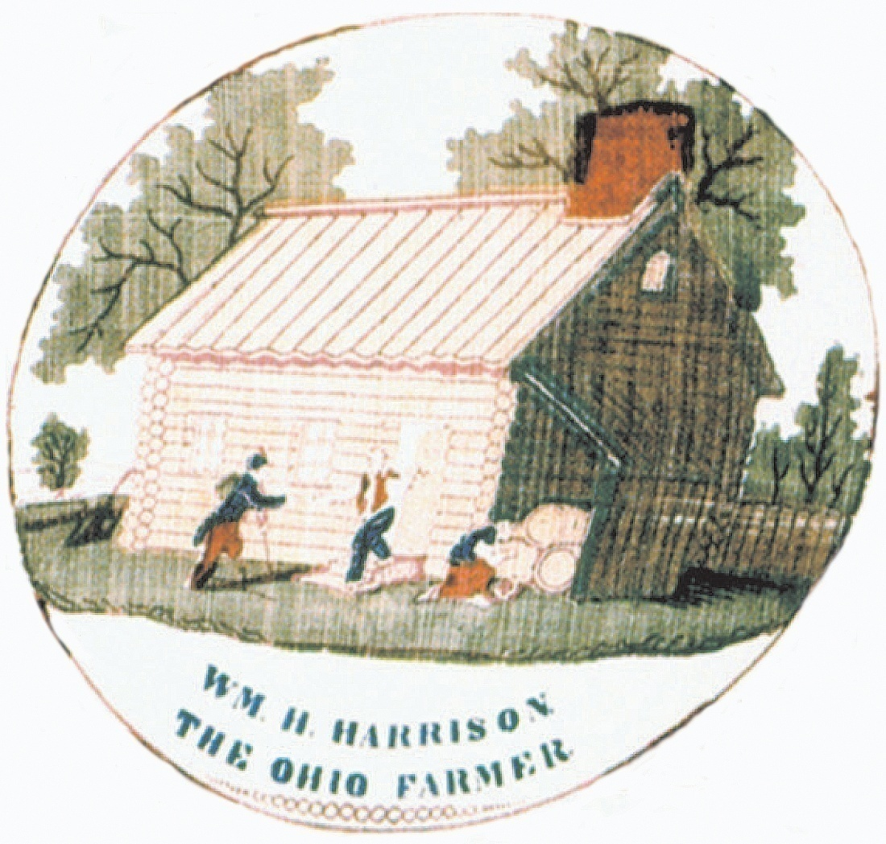
Economic Recession
Recession
Van Buren ran for re-election in 1840 against Whig candidate William Henry Harrison.
The Whigs ran a skillful campaign to appeal to ordinary voters.
Economic
Harrison easily defeated Van Buren. The Age of Jackson was over.

